Slide 1
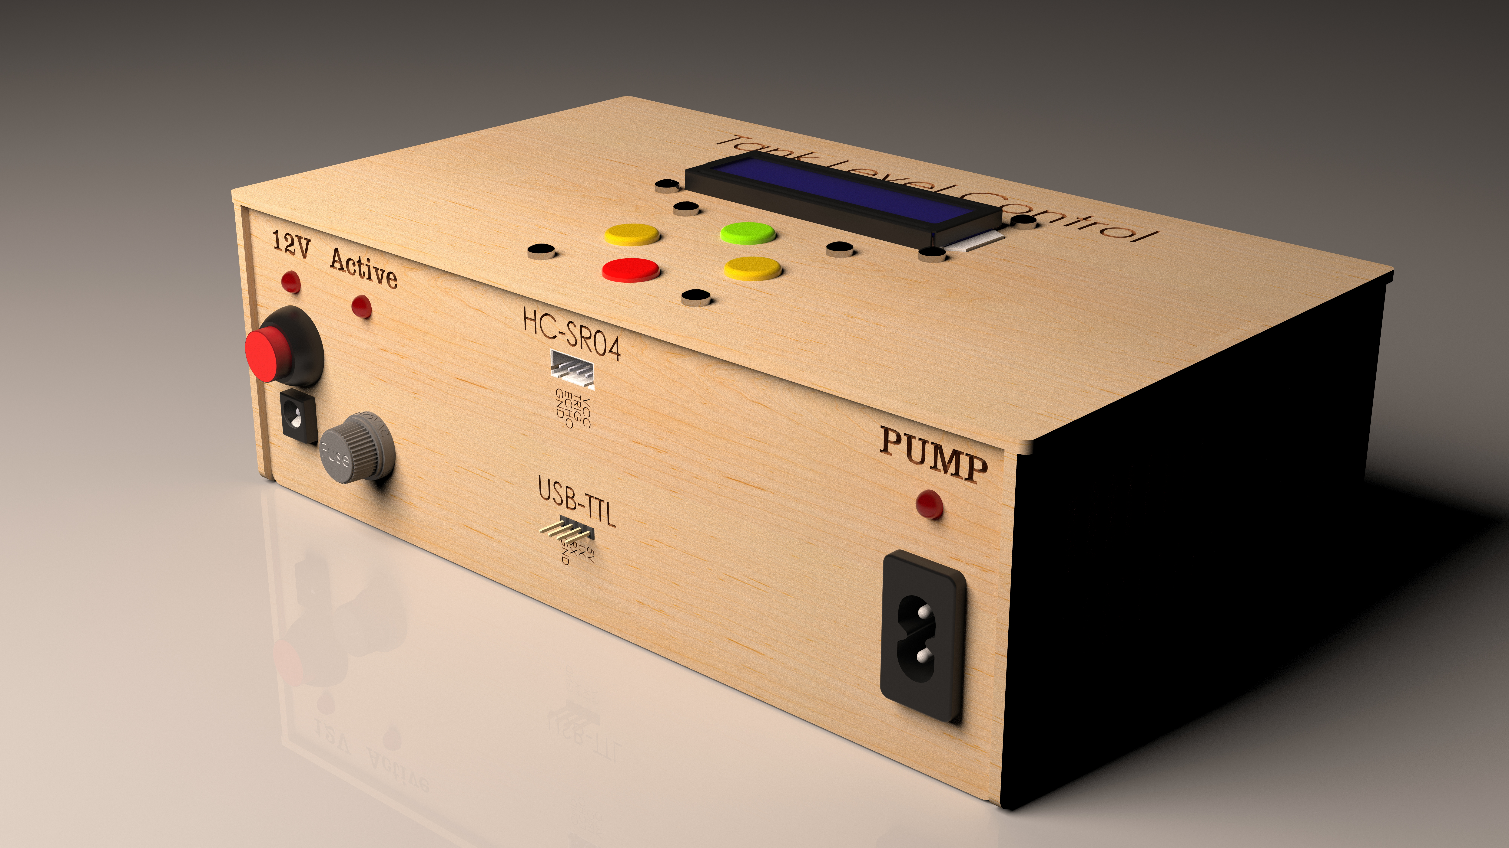
Tank Level Control

Slide 2
ABOUT US

Slide 3
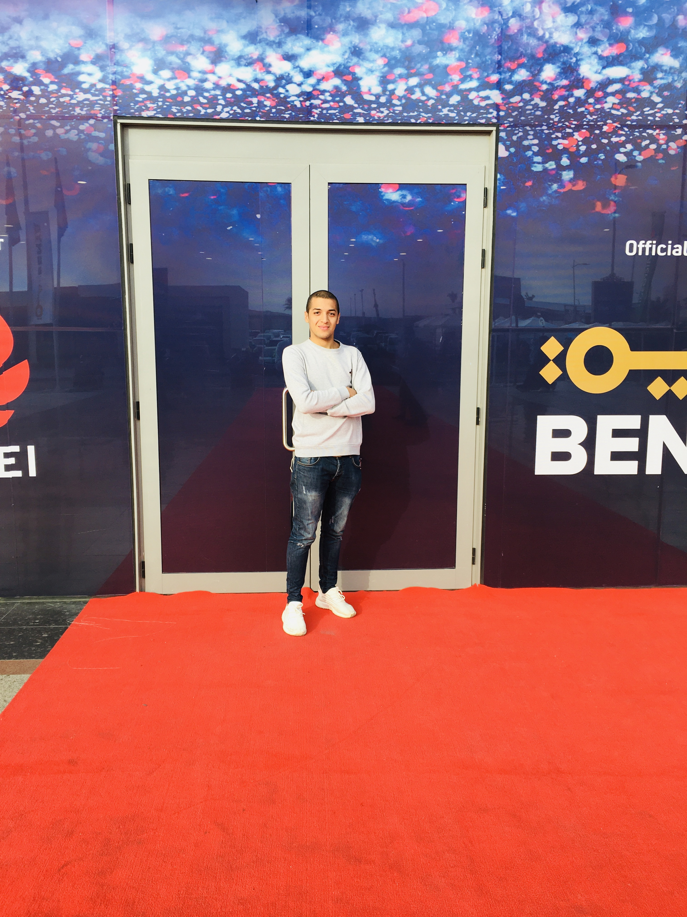






Mahmoud Karam
Adel Mustafa
Abd El-Rahman Ahmed
Mohamed Alaa
Kareem Sallam
Student
Student
Student
Student
Student
Sally Abd El-Latif
Alaa El-ghorab
Student
Student

Slide 4
Supervised by:
Dr. Sameh Abd El-Halim

Slide 5




Agenda
Idea
&
Objectives
Steps
Outcomes
&
Future

Slide 6
Idea
Industrial processes:
Food processing.
Nuclear power plants.
Water purification systems.
Industrial chemical processing.
Boilers.
etc...
Problems:
Cost of labors.
Human errors.
Controlling the speed of motor.
Production speed.

Slide 7
Objectives
Development
Main Features:
Distance Measuring and Response.
Reliable Code and Circuits.
Display System Status.
Secondary Features:
Settings page.
Add tanks, Manual and Auto.
Delete Tank.
LABVIEW Simulation.
Controlling the speed of motor.
PH Measurement.

Slide 8
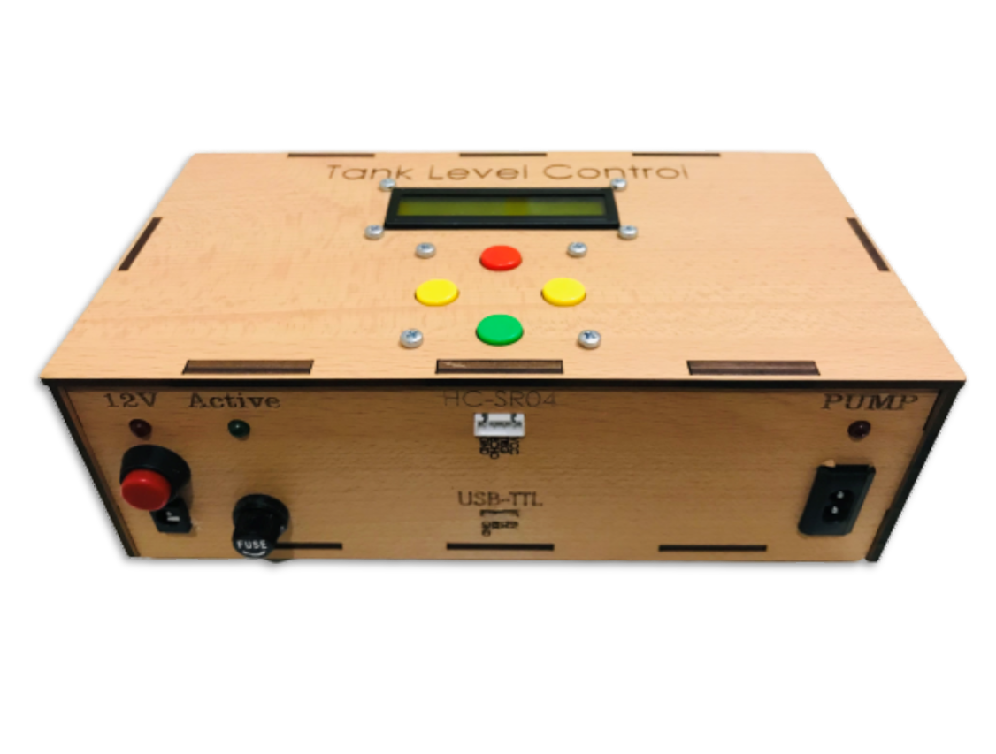







Steps
Circuit Design
and Code
PCB Design
PCB CAM
Circuit Simulation
Enclosure (SolidWorks)
Circuit Testing
Final Test

Slide 9
Steps
Circuit Design
and Code

Slide 10
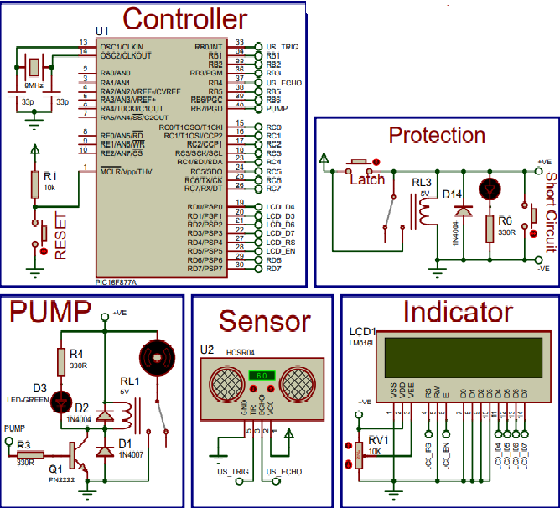
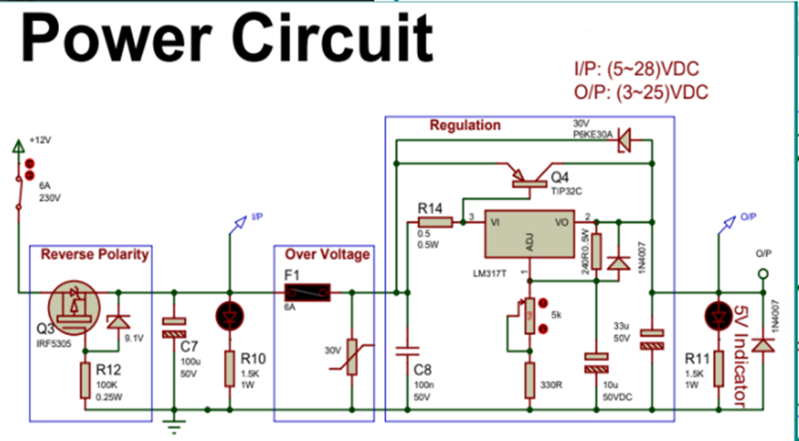
Steps
Circuit Design and Code

Slide 11
Steps
Circuit Design and Code
1. Power circuit:
Reverse Polarity.
I/P indication.
Over Voltage.
Regulation.
O/P indication.

Slide 12
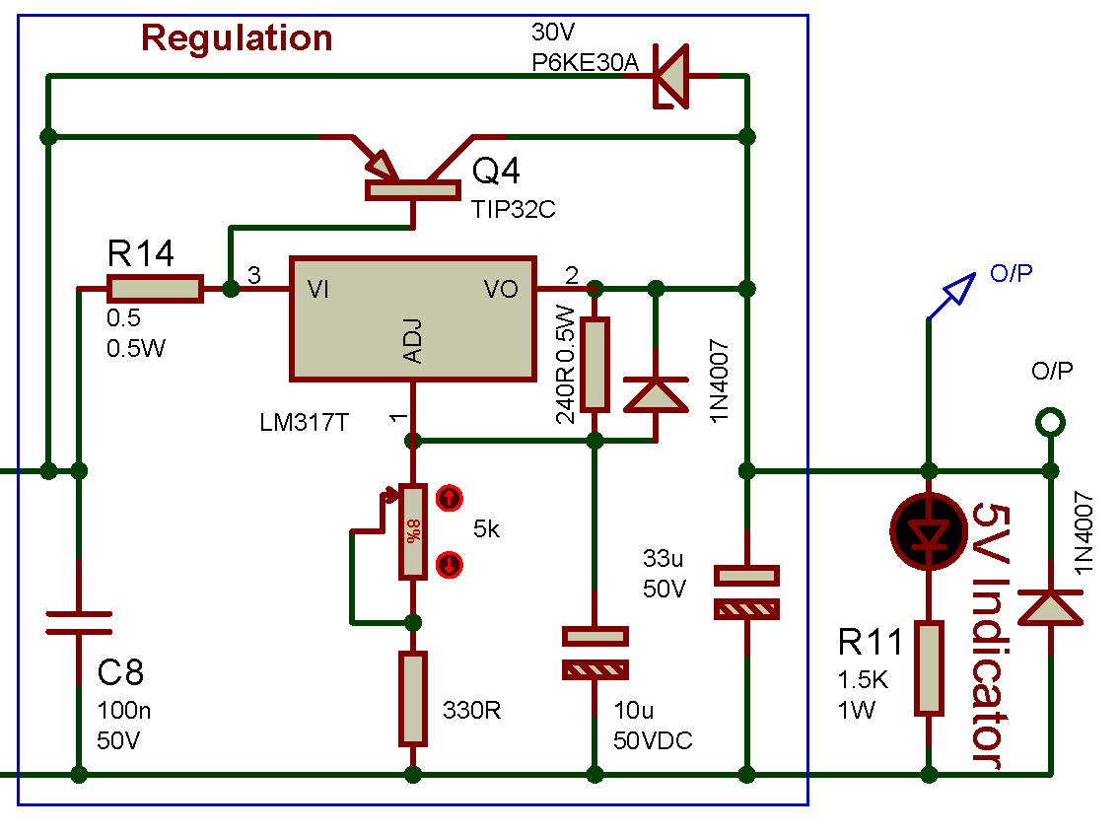
Steps
Circuit Design and Code
1.1. Regulation.
1.2. O/P indication.

Slide 13
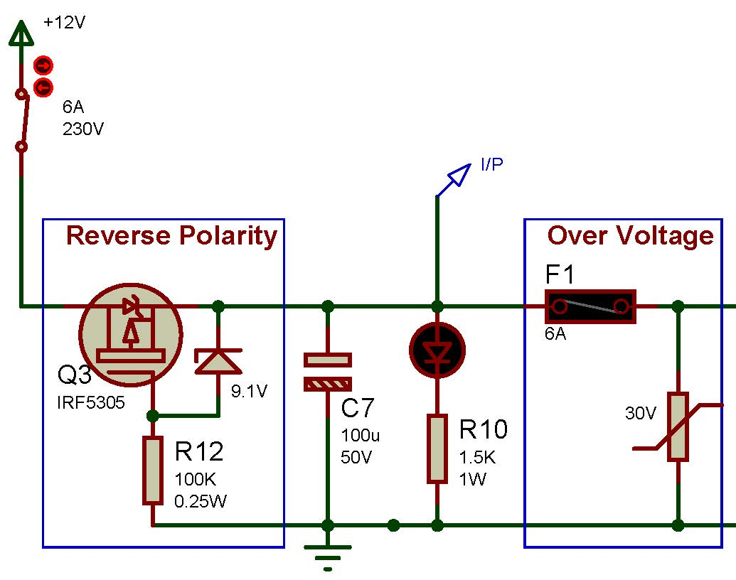
Steps
Circuit Design and Code
1.3. Reverse Polarity.
1.4. I/P indication.
1.5. Over-Voltage.

Slide 14
Steps
Circuit Design and Code
2. Control circuit:
Controller.
Pump.
Protection.
LCD Display.
Sensor.

Slide 15
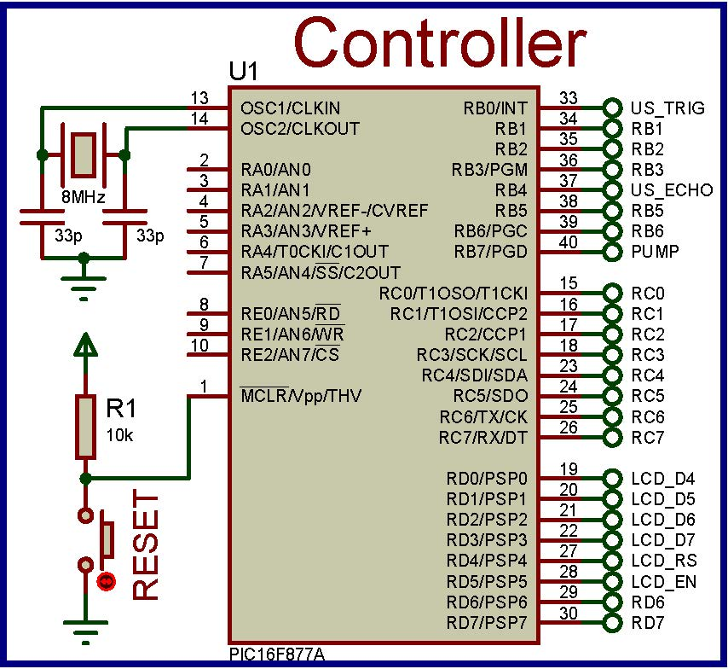
Steps
Circuit Design and Code
2.1. Controller: PIC16F877A
40 pins; 5 Ports (A to E).
3 Timers; 2 of them are 8-bit, while 1 is 16 Bit.
4-bits mode for LCD.
Availability & Price.

Slide 16
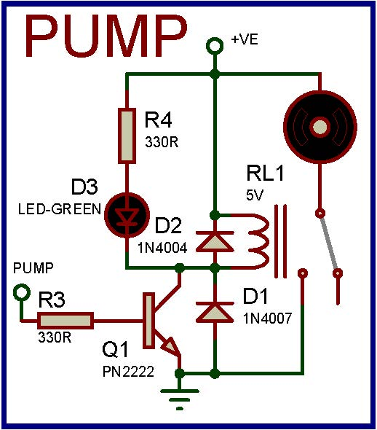
Steps
Circuit Design and Code
2.2. Pump:
Relay Interfaced.
Flywheel diodes.
LED indication

Slide 17
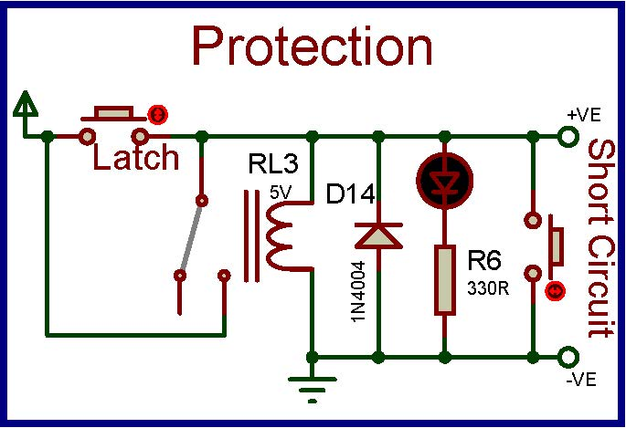
Steps
Circuit Design and Code
2.3. Protection:
Latch button.
Indicator.

Slide 18
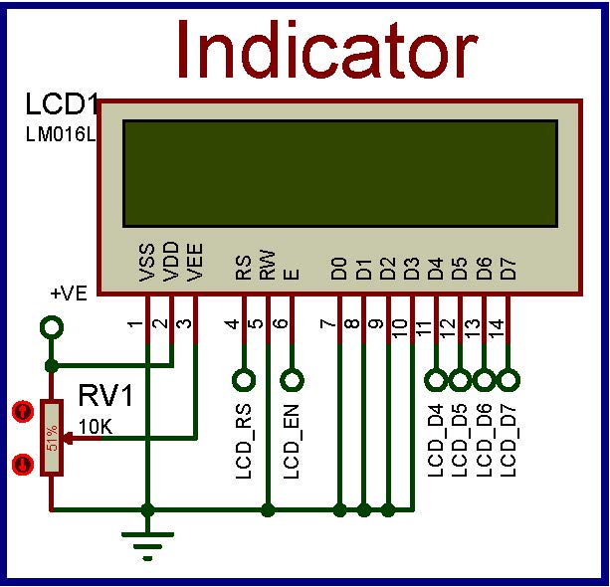
Steps
Circuit Design and Code
2.4. LCD Display (char: 16*2):
4-bits mode.
Contrast potentiometer.

Slide 19
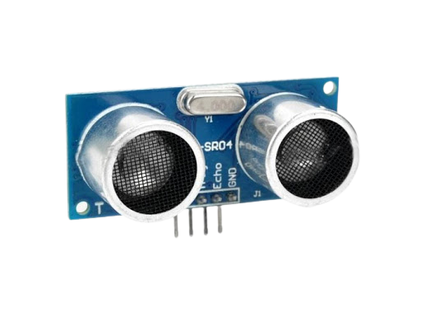
Steps
Circuit Design and Code
2.5. Sensor: there are many types:
Proximity sensor.
Wire Sensing.
Water sensors.

Slide 20
Steps
Circuit Design and Code
2.5. Sensor: HC-SR04
Ultrasonic proximity sensor (non-contact).
Range: 2cm ~ 4m
Accurate measurement: 3mm
Low Power: 15mA, 5V

Slide 21
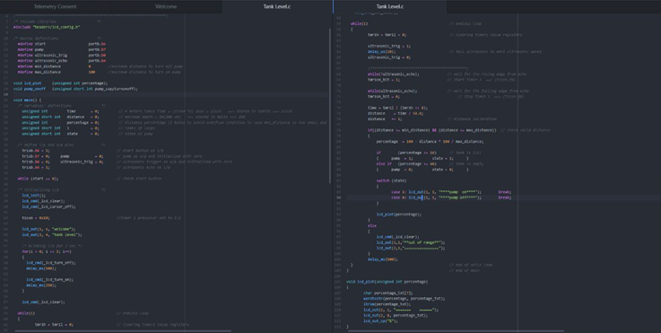
Steps
Circuit Design and Code
Code Section

Slide 22
Steps
Circuit Simulation
Power Circuit.
Control Circuit.

Slide 23
Steps
Circuit Testing

Slide 24
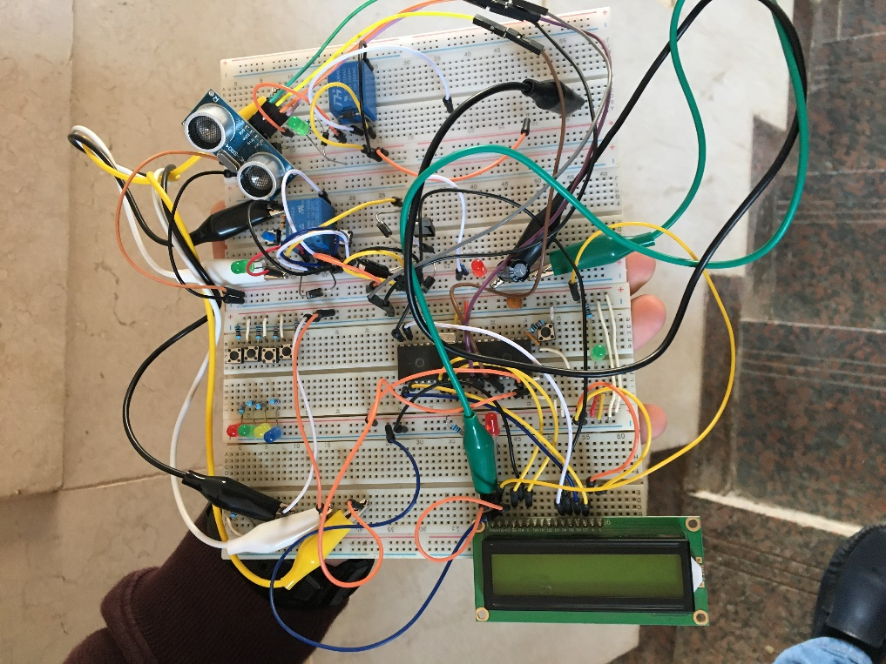
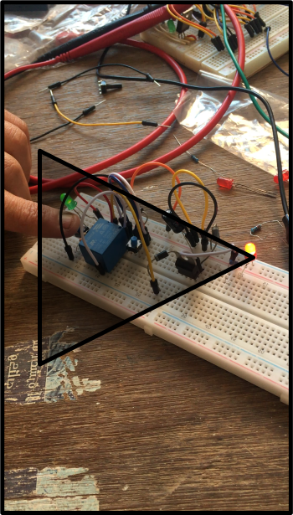
Steps
Circuit Testing
NOTE: click on video to play

Slide 25
Steps
PCB Design
Control Circuit.
Power Circuit.
Arrows Keypad.

Slide 26
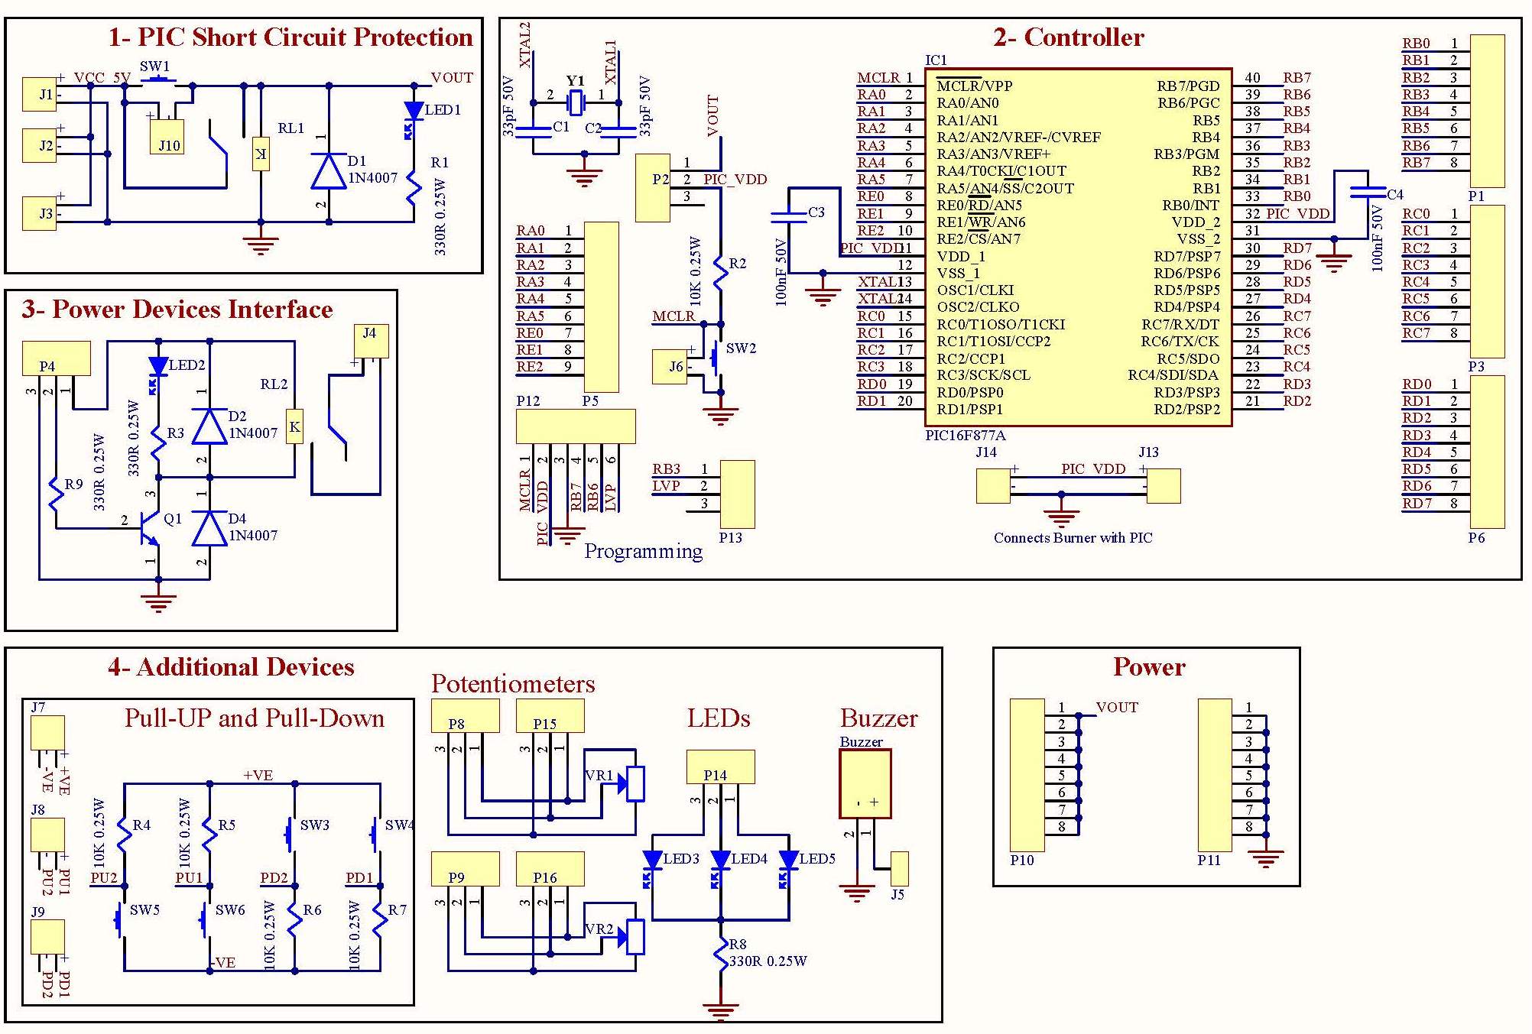

Slide 27
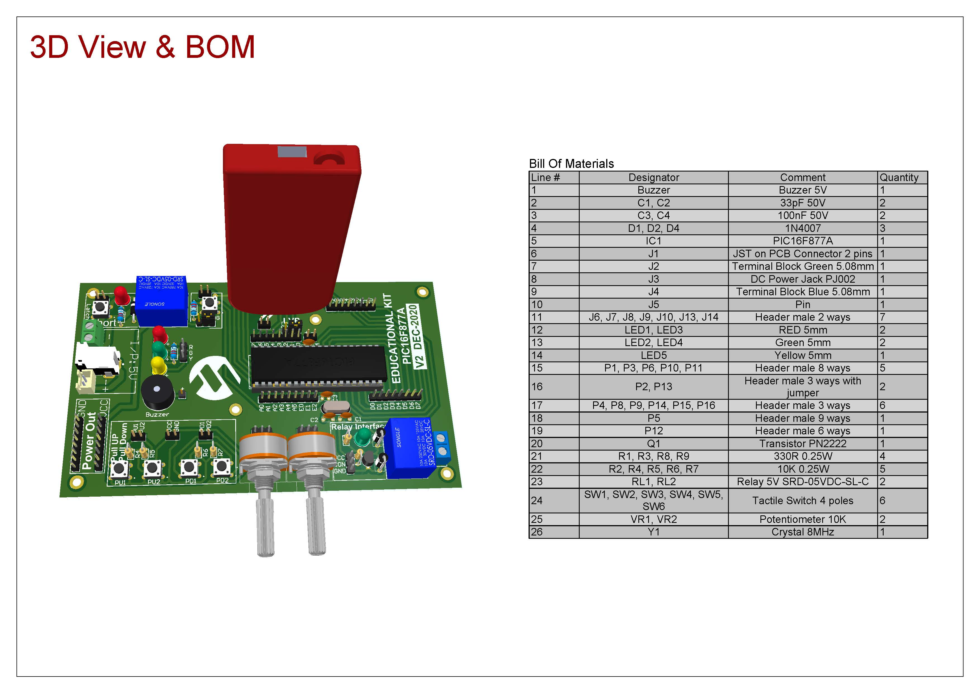

Slide 28
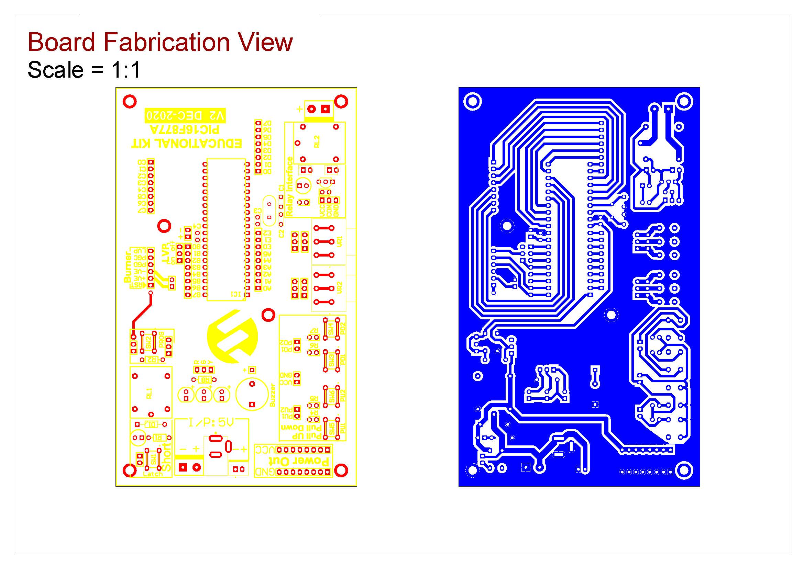

Slide 29
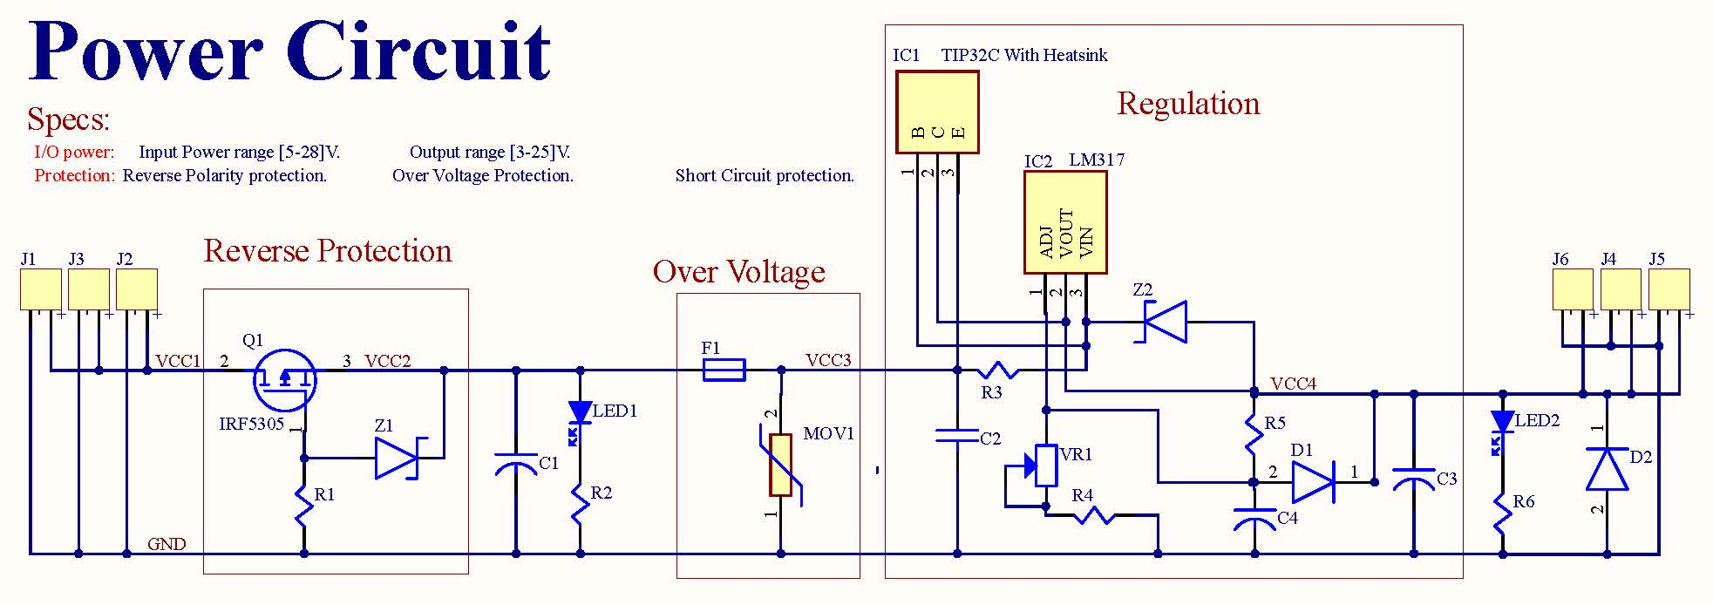

Slide 30
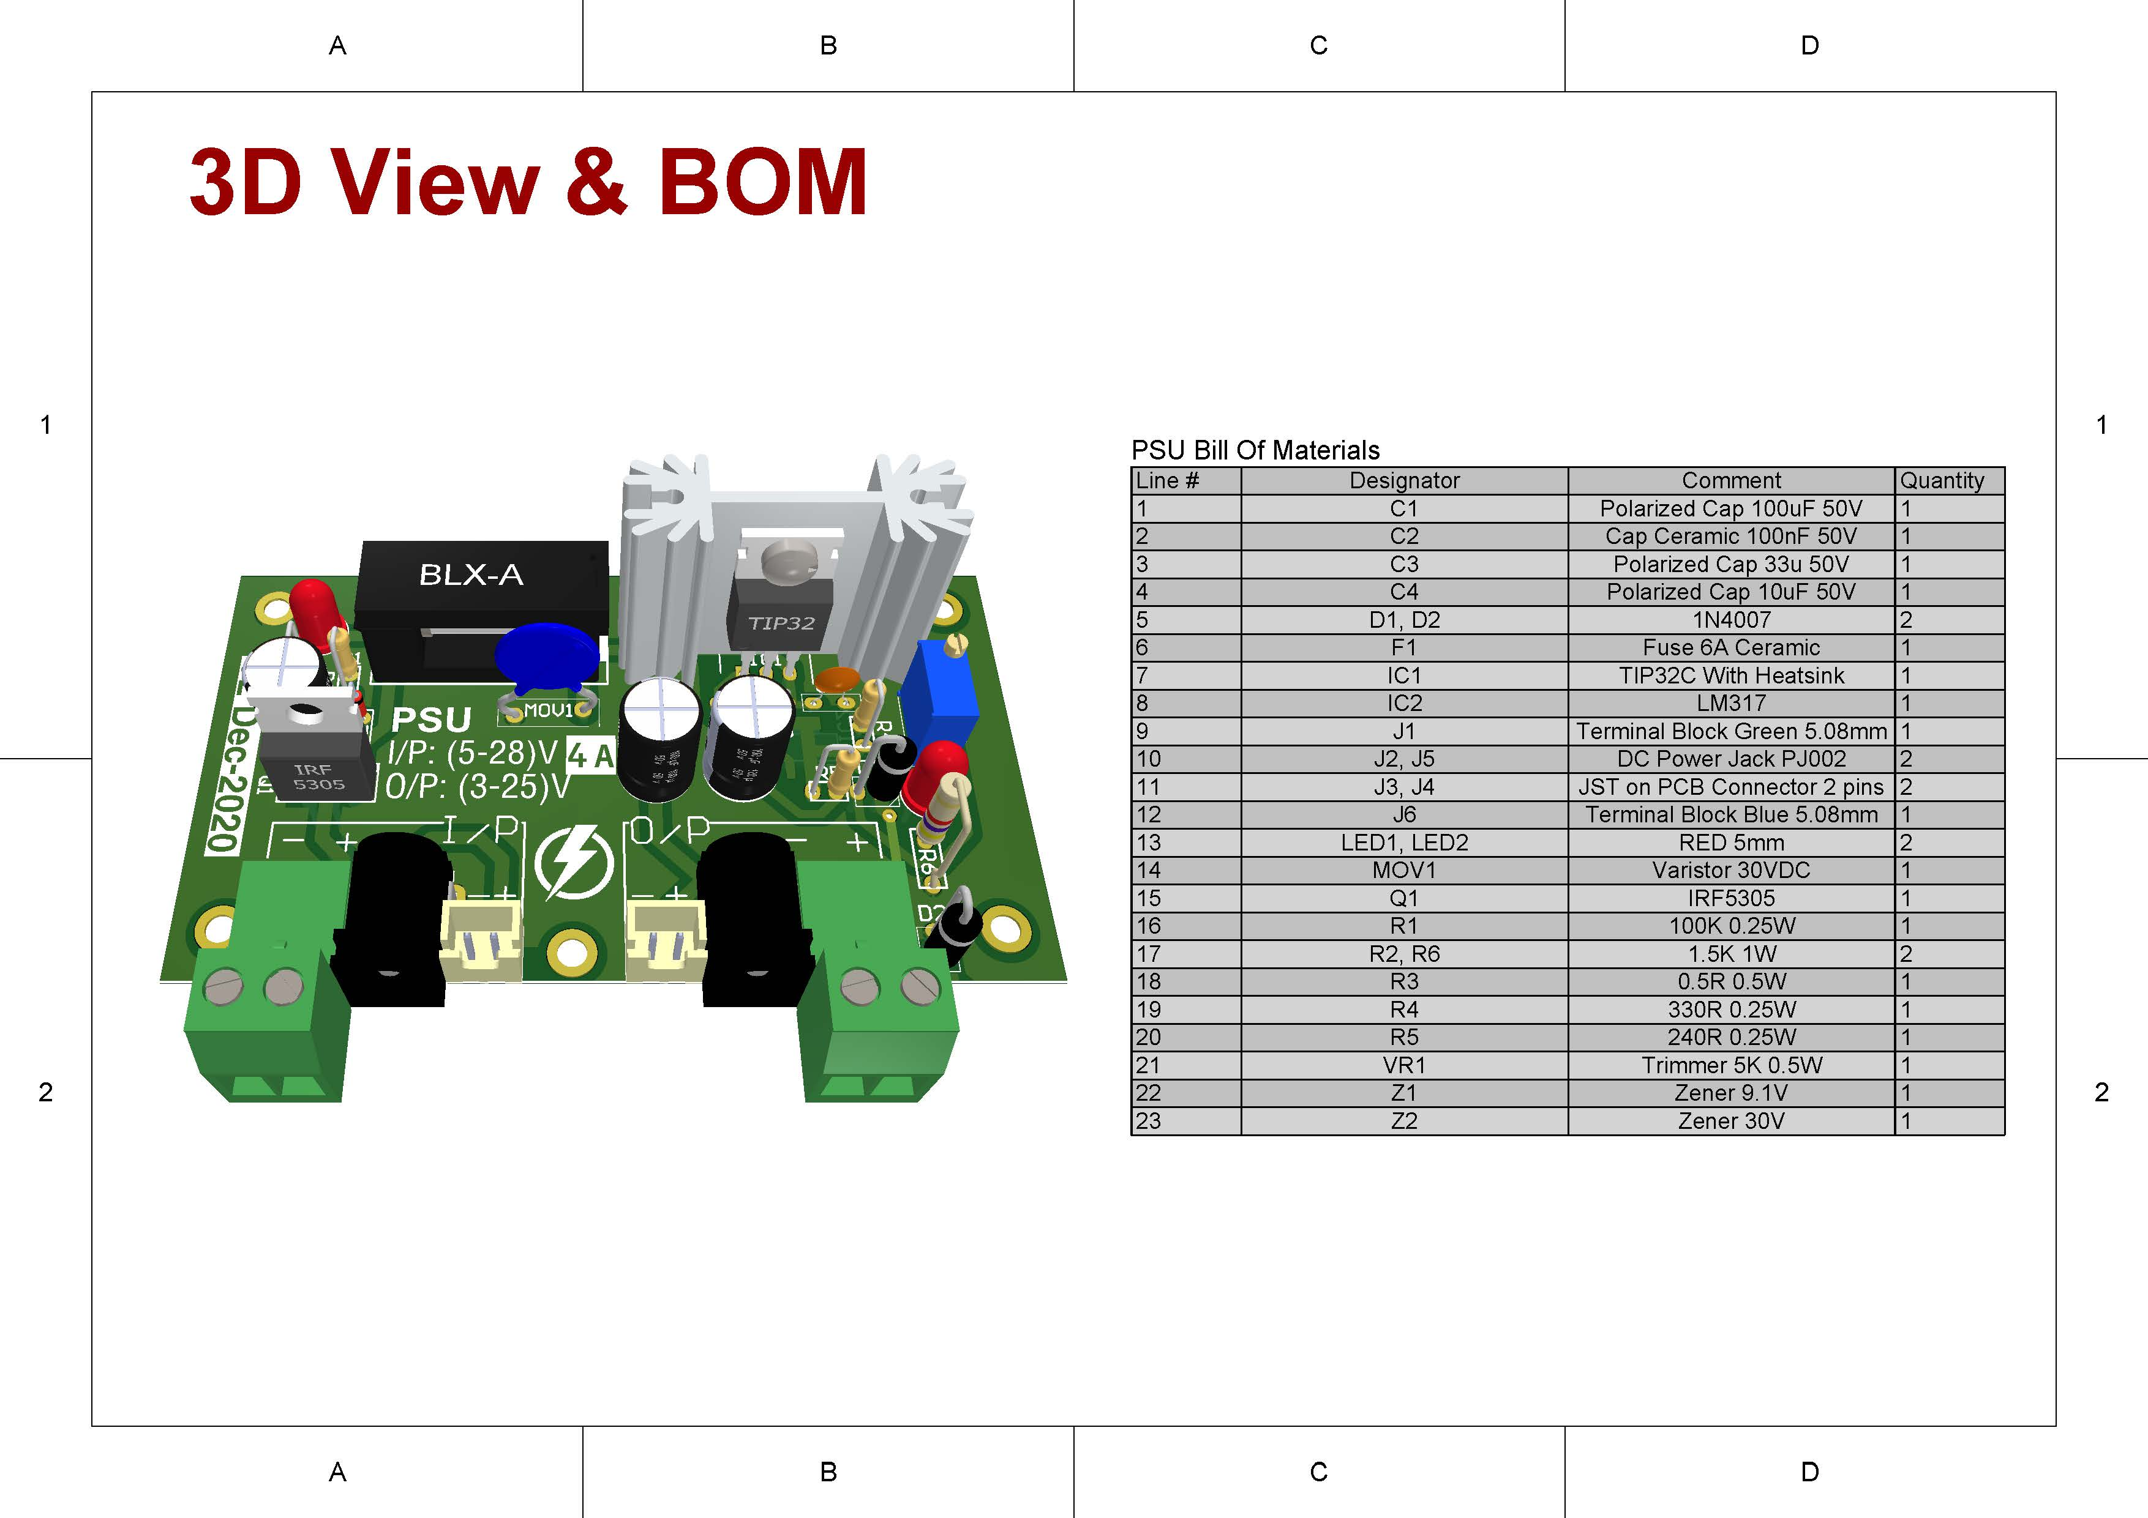

Slide 31
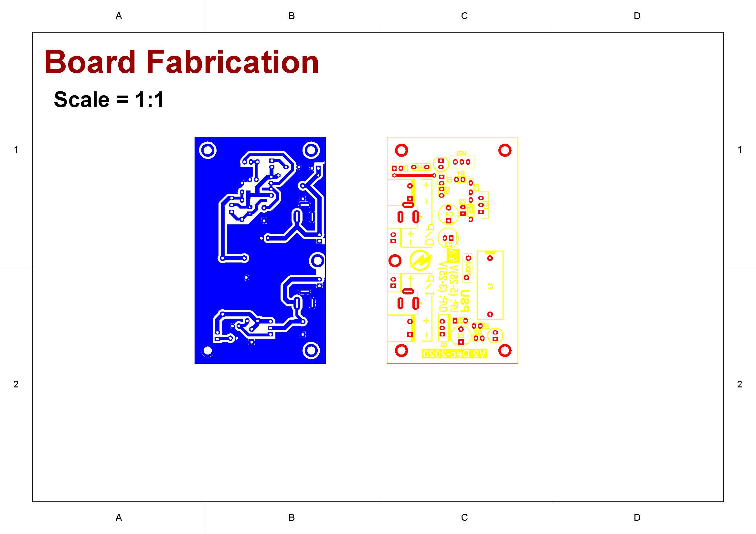

Slide 32
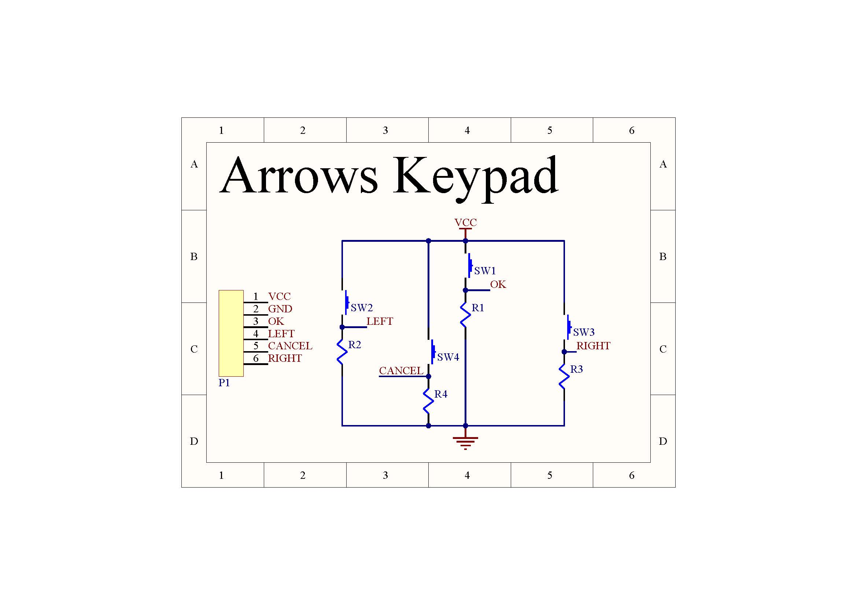
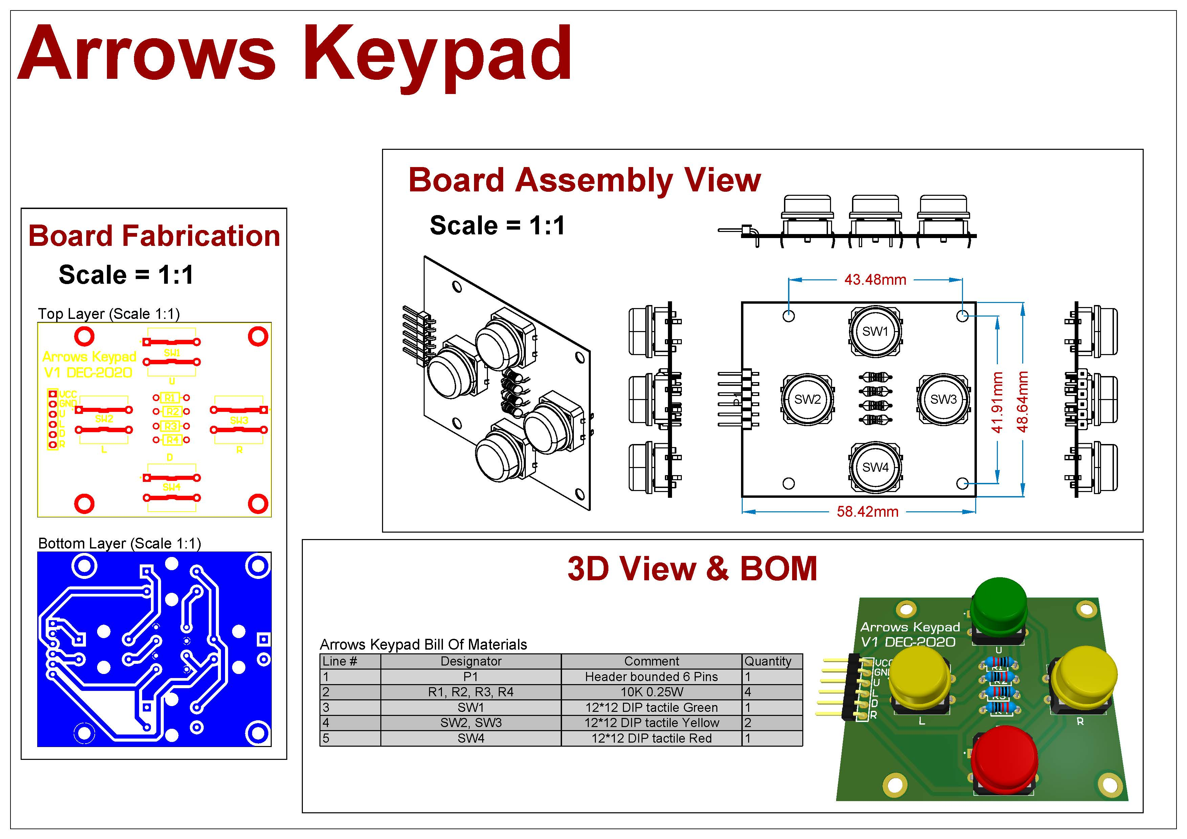

Slide 33
Steps
PCB CAM

Slide 34
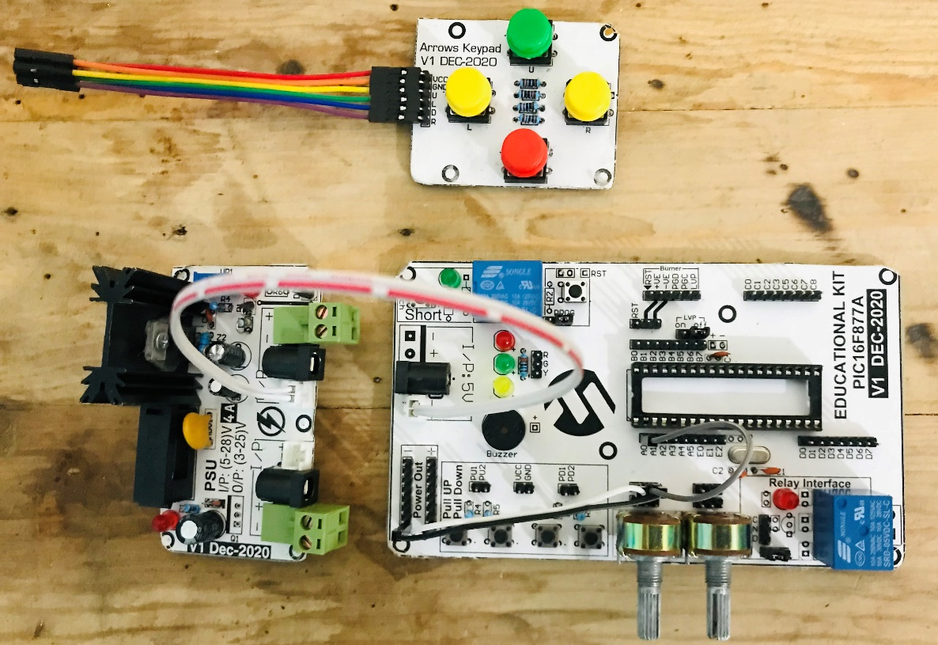

Slide 35
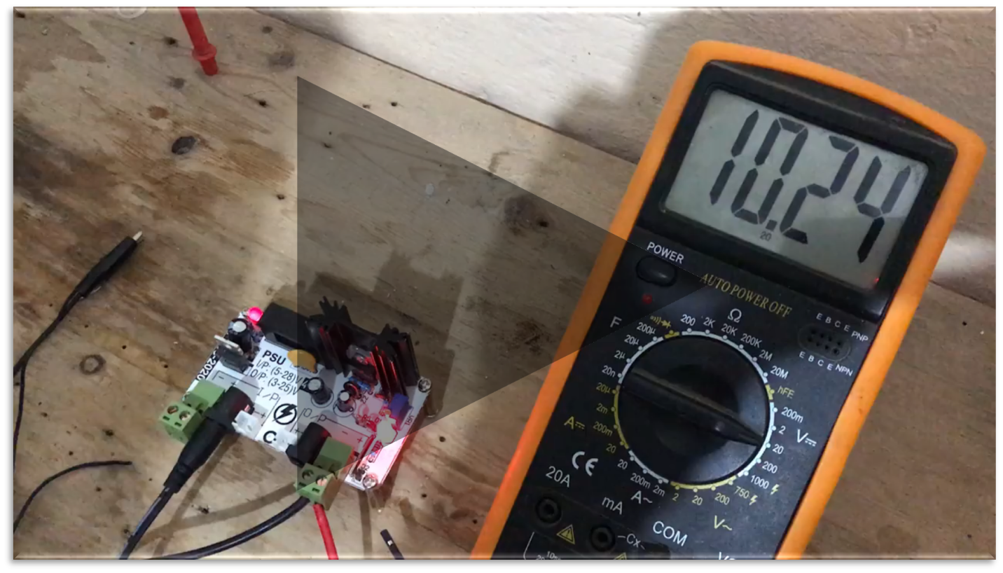
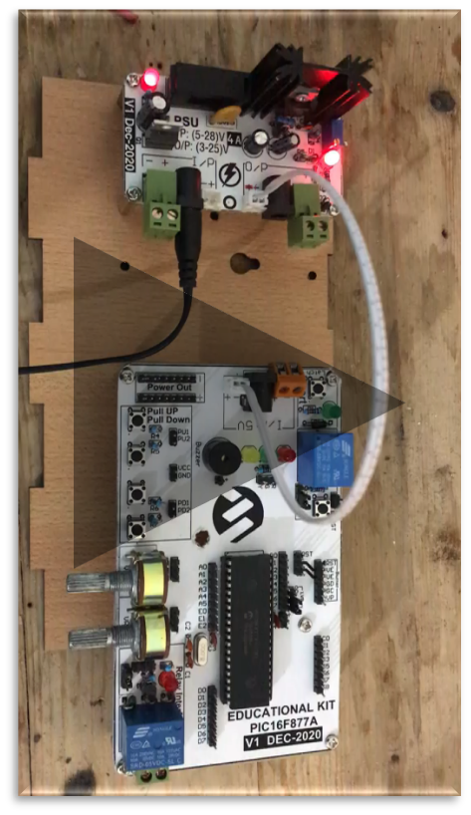
Steps
PCB CAM: PCB Testing
NOTE: click on video to play

Slide 36
Steps
Enclosure (SolidWorks)

Slide 37

Enclosure (SolidWorks)

Slide 38
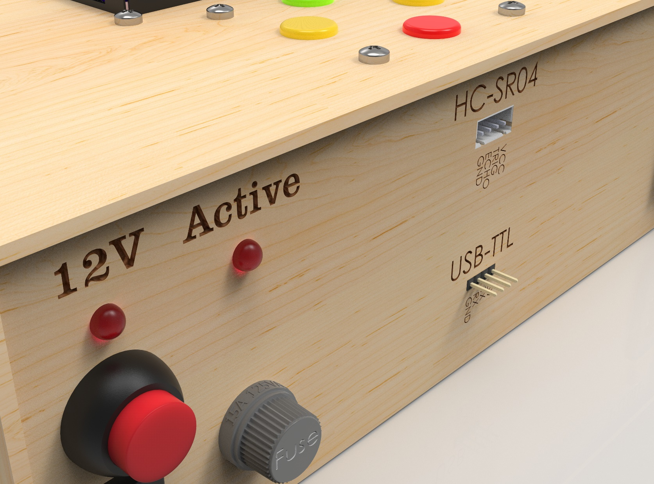
Enclosure (SolidWorks)

Slide 39
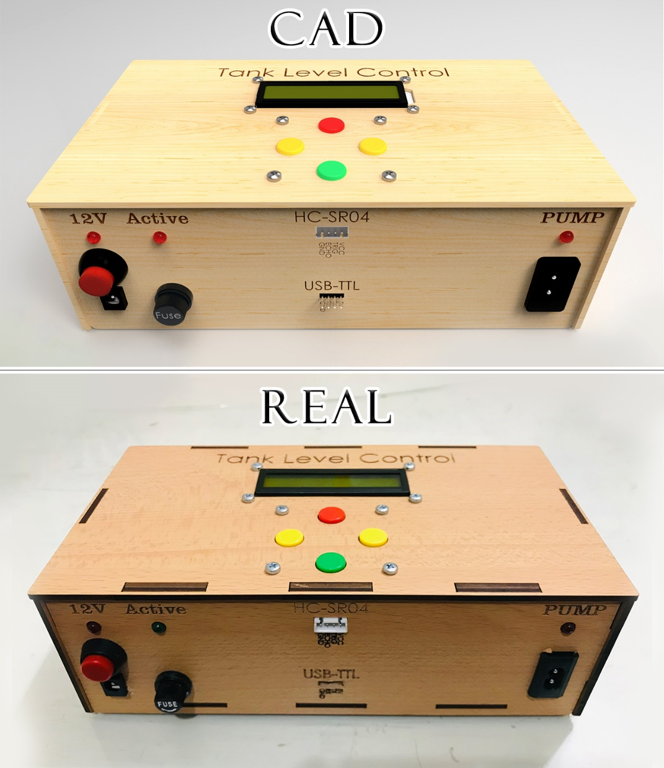
Enclosure (SolidWorks)

Slide 40
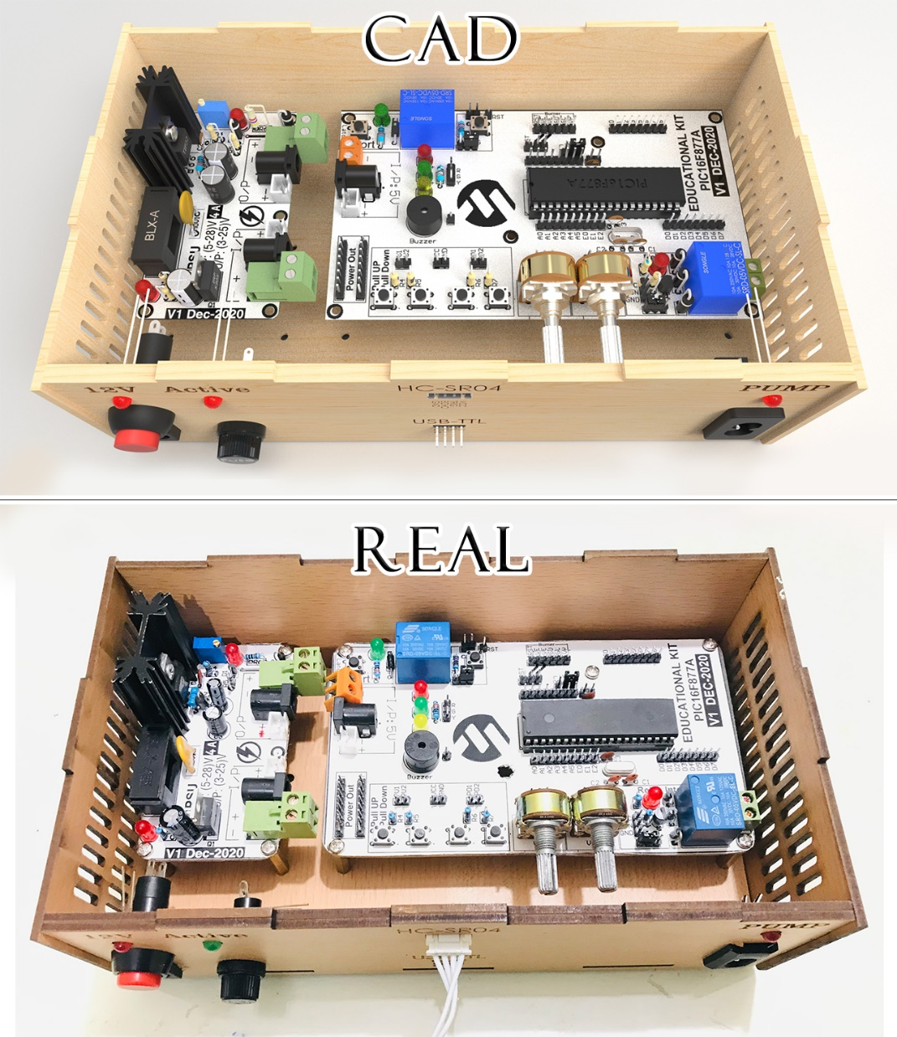
Enclosure (SolidWorks)

Slide 41
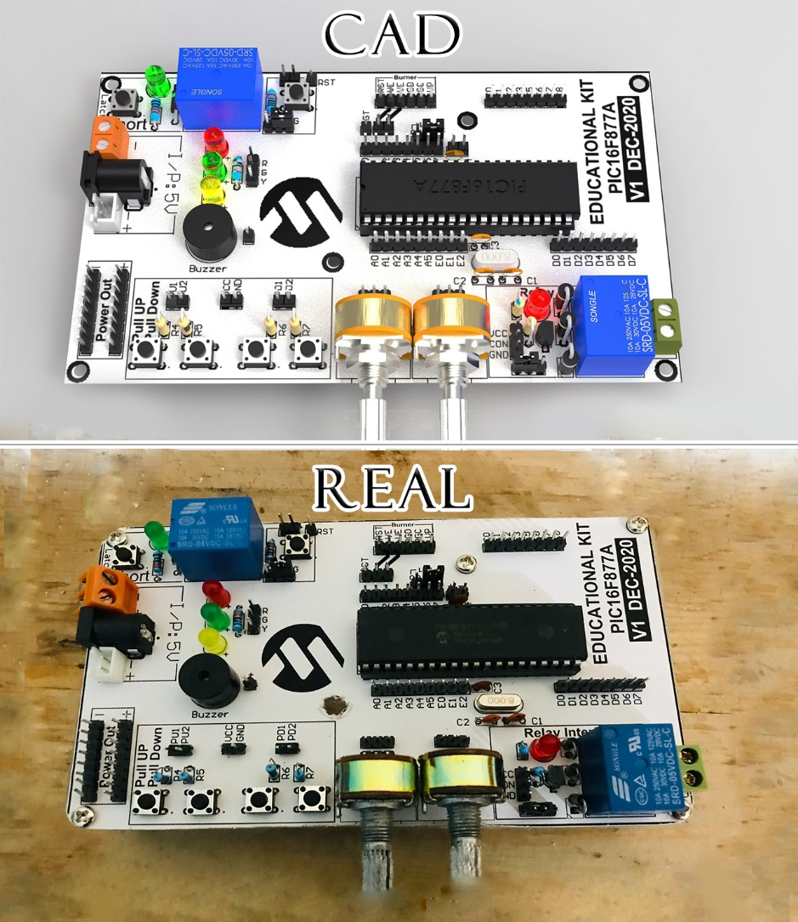
Enclosure (SolidWorks)
6.1. Control circuit

Slide 42
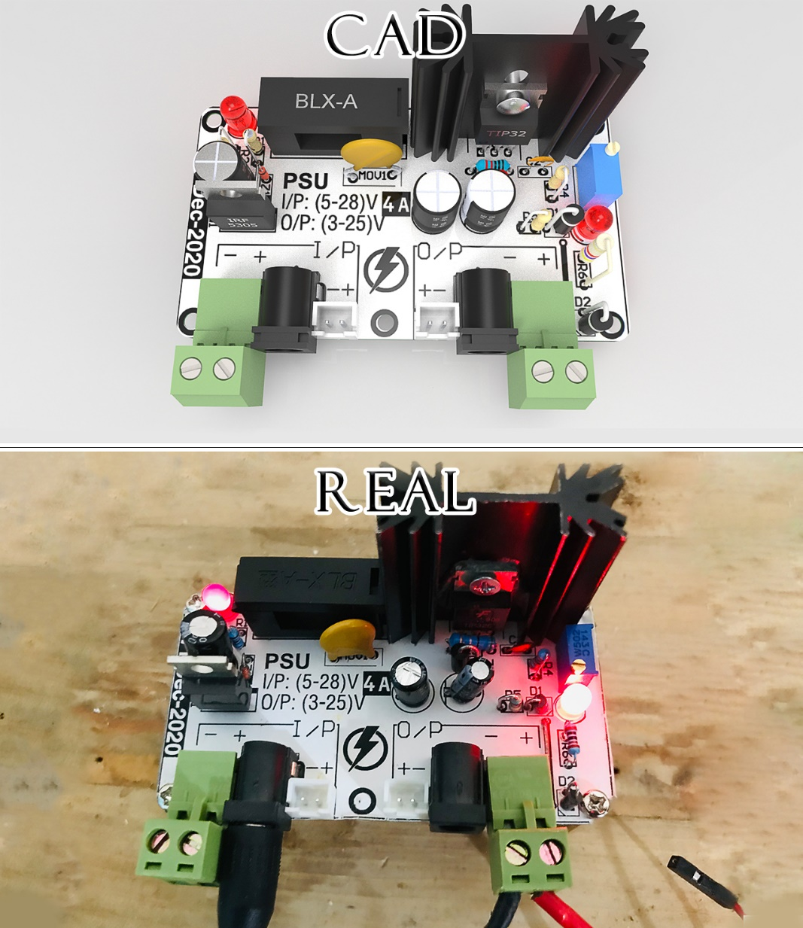
Enclosure (SolidWorks)
6.2. power circuit

Slide 43
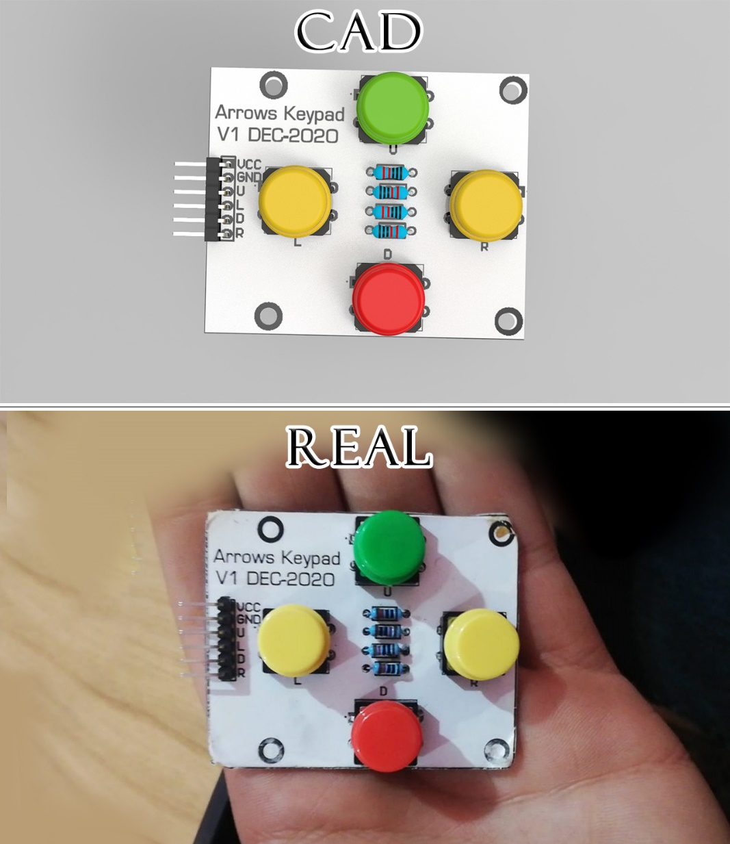
Enclosure (SolidWorks)
6.3. Keypad circuit

Slide 44
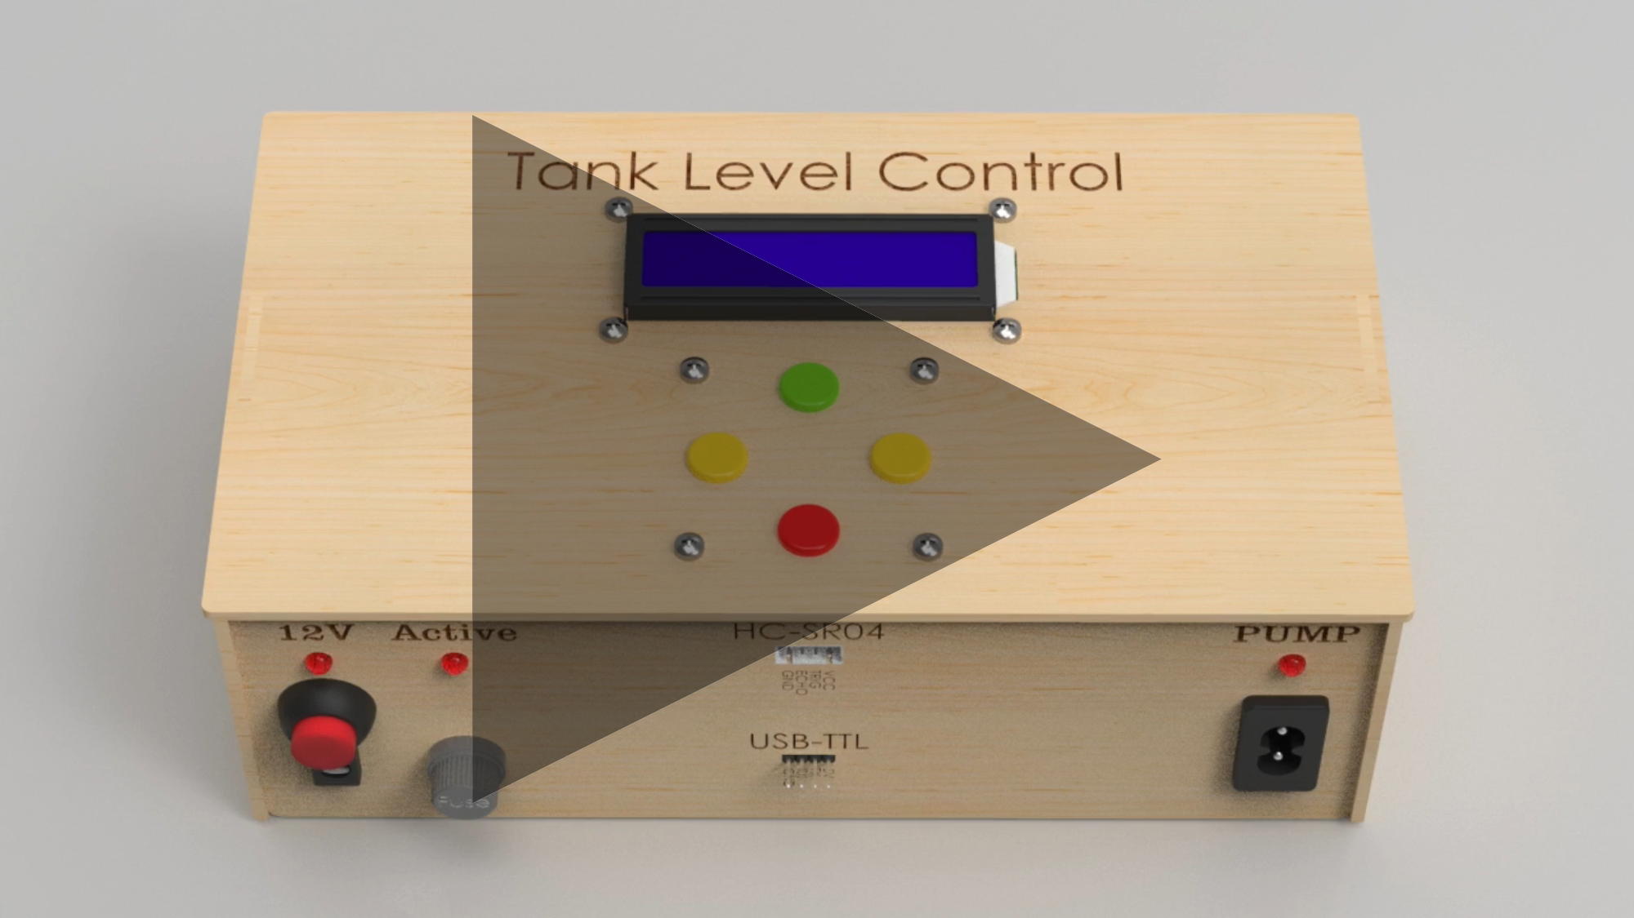
NOTE: click on video to play

Slide 45
Steps
Final Testing

Slide 46
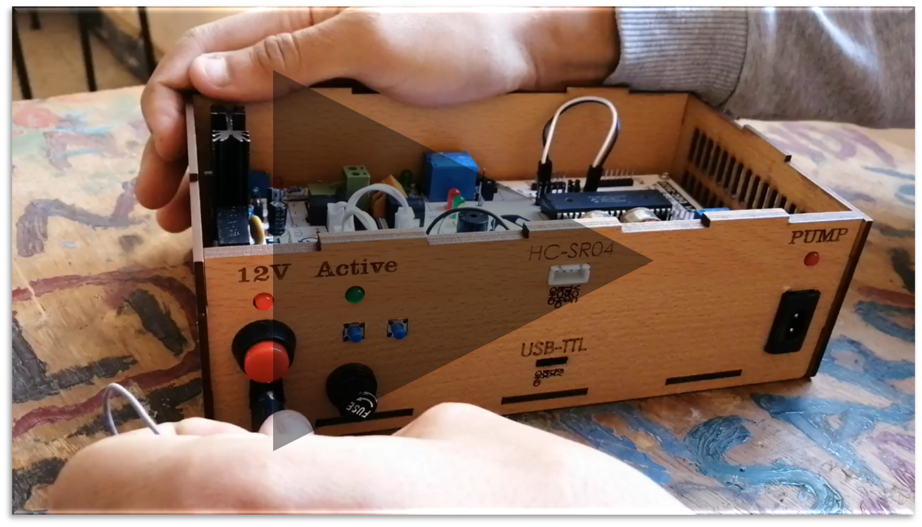
Steps
NOTE: click on video to play

Slide 47
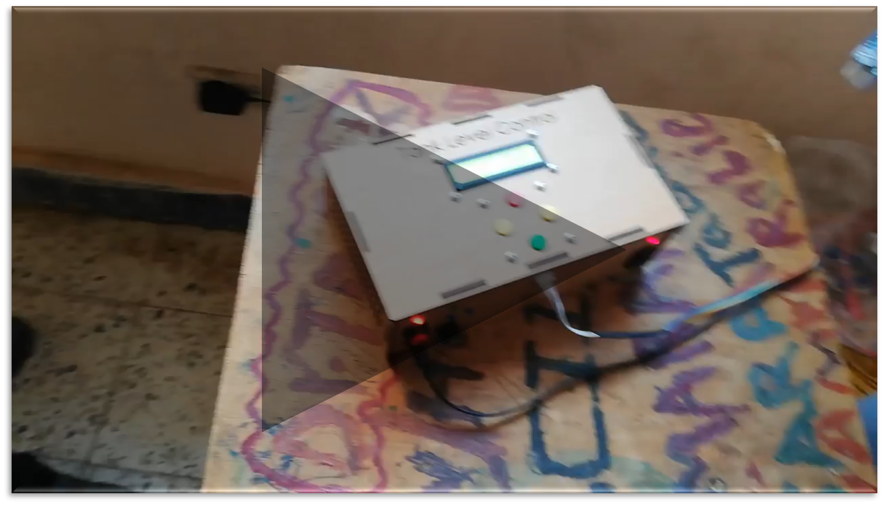
Steps
NOTE: click on video to play

Slide 48
Main Features
100%
100%
100%
Distance Measuring and Response
Reliable Code and Circuits
Display System Status
Outcomes
&
Future

Slide 49
Secondary Features
80%
50%
0%
0%
Settings page
LABVIEW Simulation
Controlling the speed of motor
PH Measurement
Outcomes
&
Future

Slide 50
LabVIEW is used for 4 main purposes:
Automated Manufacturing test of a component/verify your product
Automated Product design validation of a component/sub-system/system.
.
.
Outcomes
&
Future
Condition monitoring of a machine/reducing maintenance costs.
Control and/or monitoring of a machine/rapid prototyping/ high-speed signals

Slide 51
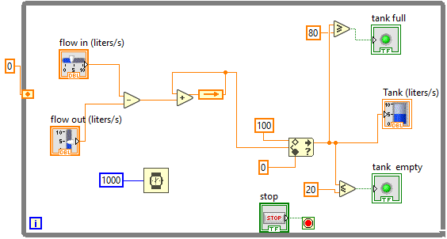
Secondary Features
Labview Simulation
Block diagram:
Outcomes
&
Future

Slide 52
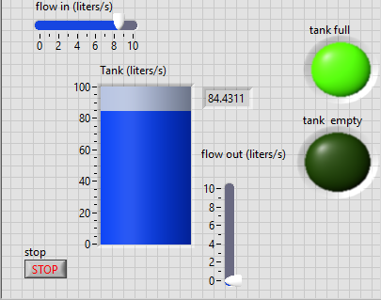
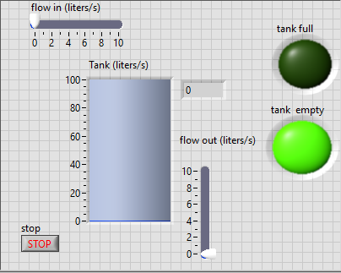
Secondary Features
Labview Simulation
Front Panel:
Outcomes
&
Future

Slide 53

Thanks!

